Slide 1
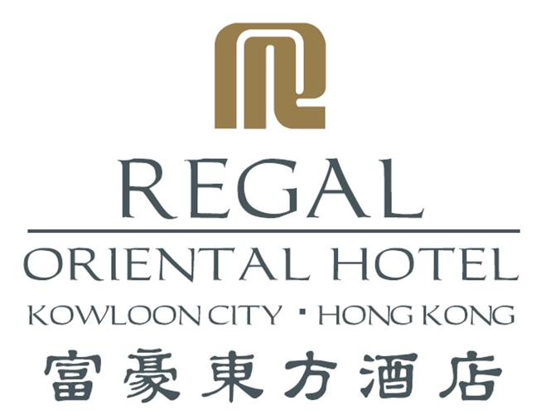
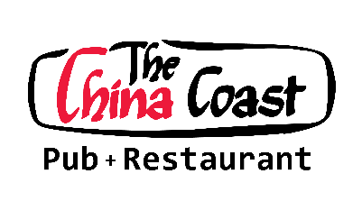
Drink Menu
20241007

Slide 2
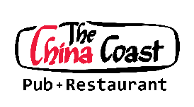
Aperitifs Glass
Campari $92
Dubonnet $92
Fernet Branca $92
Martini Bianco $92
Martini Dry $92
Martini Rosso $92
Pernod $92
Ricard $92
Sherrie & Ports Glass
Harvey’s Bristol $92
Tio Pepe Dry Sherrie $92
Taylor’s Port Wine $92
Spirits
Gin Glass
Gordon’s $92
Non-alcohol Gin Glass
Sabatini Gin-o Sabatini $92
Rum Glass
Bacardi Rum $92
Malibu $92
Myer’s Dark $92
Tequila Glass
Jose Cuervo Silver $92
All nuts are charged to HK$20 per head
All prices are in Hong Kong Dollars and subject to 10% service charge
Corkage fee $200
1
10

Slide 3
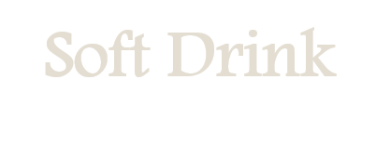
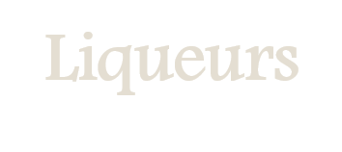
Soft Drink Glass
Vodka Glass
Absolute Citron $102
Chopin $132
Smirnoff $102
Brandy Glass
Calvados Coeur De Lion $212
Coke $58
Coke Light $58
Seven-up $58
Tonic Water $58
Ginger Beer $58
Ginger Ale $58
Fresh Juice Glass
Liqueurs Glass
Fresh Orange Juice $58
Amaretto $92
Bailey’s Irish Cream $92
Bénédictine DOM $92
Cointreau $92
Drambuie $92
Grand Marnier $92
Kahlua $92
Limoncello $92
Sambuca $92
Tia Maria $92
Non-alcohol Liqueurs Glass
Magi Amaro Venti $88
Sparkling Water Bottle
Perrier $68
Distilled Water Bottle
Evian $68
All nuts are charged to HK$20 per head
All prices are in Hong Kong Dollars and subject to 10% service charge
Corkage Fee $200
9
2

Slide 4
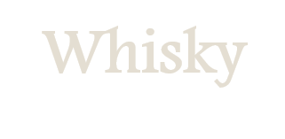
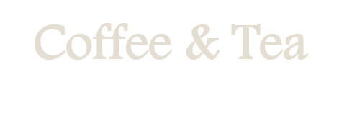
Scotch
Glass Bottle
$138 $980
$93 -
$93 -
$93 -
$138 $1,080
$208 $2,200
$358 $4,180
$118 $788
$98 $888
$158 $1,480
Coffee and Tea
Coffee
Cappuccino
Coffee Latte
Single Espresso
Double Espresso
Lemon Tea
Milk Tea
Chocolate
Hot Iced
$48 $58
$48 $58
$48 $58
$48 -
$68 -
$48 $58
$48 $58
$48 $58
CHIVAS Regal 12 Years
Dimple 12 Years
Dimple 15 Years
Johnnie Walker Red Label
Johnnie Walker Black Label
Johnnie Walker Gold Label
Johnnie Walker Blue Label
Matisse Old Scotch Whisky
The Famous Grouse 12 Years
The Macallan 12 Years
Irish
Glass Bottle
$93 -
John Jameson
Tea
Camomile Tea
Earl Grey
English Breakfast Tea
Jasmine Green Tea
Hot Iced
$48 -
$48 -
$48 -
$48 -
Canada
Glass Bottle
$93 -
Canadian Club
USA
Glass Bottle
$93 -
$93 -
$93 -
Jim Beam (Bourbon)
Jack Daniel’s (Tennessee)
Southern Comfort
Japan & Taiwan
Glass Bottle
$168 -
$308 -
$98 -
Hakushu 12 Years
Hibiki Whisky 17 Years
Kavalan Whisky
Malt Whisky
Glass Bottle
$158 -
$158 -
$350 -
Balvenie 12 Years
Glenfarclas 12 Years
Macallan Whisky 18 Years
All nuts are charged to HK$20 per head
All prices are in Hong Kong Dollars and subject to 10% service charge
Corkage Fee $200
3
8

Slide 5
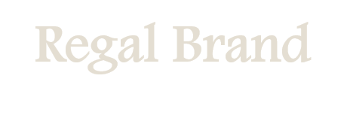
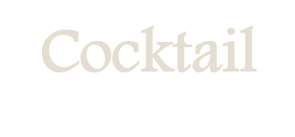
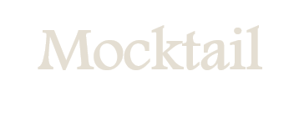
Regal Brand
Regal Margaux 2006
Regal Margaux 2015
Regal Mapachi 2018 (PT)
Regal Red Wine
Regal White Wine
Glass Bottle
- $520
- $520
- $210
$82 $450
$82 $450
Cocktail Glass
Around The World $112
Bloody Mary $112
Cosmopolitan $112
Manhattan $112
Mai Tai $112
Martini Cocktail $112
Salt Dog $112
Sex on the Beach $112
Snowball $112
White Russia $112
Sparkling Wine
Saint Louis
Blanc de Blancs Brut 75cl
Bottle
$428
Champagne
Champagne Bottle
Veuve Clicquot Burt $890
Mocktail Glass
Fruit Punch $98
Lime Soda $98
All nuts are charged to HK$20 per head
All prices are in Hong Kong Dollars and subject to 10% service charge
Corkage Fee $200
7
4

Slide 6
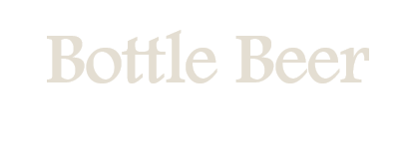
Draught Beer
Half-pint Full-pint
$96 $118
$86 $108
$96 $118
$96 $128
$96 $128
$96 $128
$96 $128
Bottle Beer
Bottle
$88
$88
$88
$88
$88
Asahi
Carlsberg
Carlsberg Smooth
Guinness
Hoegaarden
Stella Artois
Kronenbourg 1664 Blanc
Blue Girl
Kronrnbourg 1664 Blanc
Carlsberg
San Miguel
Tsing Tao
Bottle Craft Beer
Bottle
$88
$88
$88
$88
$88
$88
$88
$88
$88
$88
Brooklyn Larger
Brooklyn Defender IPA
YAU - Fat Siu Yau Pale Ale
YAU - Joy Guy Suen Yau T.IPA
YAU - Bor Yau Larger
Poretti Orignale (No.4)
BAV - Dritta Pale Ale
BAV - Alouette Blanche
BAV - Strike IPA
BAV - Furia Scotch Ale
Alcohol-free Beer
Tin
$88
Carlsberg 0.0% Alcohol-free Beer
All nuts are charged to HK$20 per head
All prices are in Hong Kong Dollars and subject to 10% service charge
Corkage Fee $200
5
6

